Slide 1
Cancer Biology Biol 445
Spring 2020
Dr. Heidi Super
Lecture 29
4-20-2020

Slide 2
Announcements
Quiz 5 –One week. April 27th.

Slide 3
Where were we?
Cancer treatment
Surgery
Radiation
Chemotherapy

Slide 4
Radiation’s mechanism of killing cancer cells
1. p53 initiated apoptosis.
(p53-mutants)
2. Mitotic death/catastrophe---recall ionizing radiation can cause DNA breaks. Cells cannot properly complete mitosis with fragmented DNA. Cells die while in the process of dividing at later stage---recall spindle checkpoint.

Slide 5
Classes of cancer chemotherapy Chapter 11
Antimetabolites—aminopterin, methotrexate
Alkylating agents
Antibiotics
Plant-derived enzyme or cell structure inhibitors
Hormone therapy
*Peek back at chapter 5 (figures 5-11 and 5-12)
DNA is susceptible to attack!

Slide 6
other antimetabolite analogs
Base analogs—discussed as mutagens previously
5-fluorouracil
Cytorabine
Mercaptopurine
Thioguanine
Mechanism=incorporate into DNA disrupt or lead to incorrect DNA basepairing

Slide 7
Alkylating agents developed related to nitrogen mustard.
In common use:
Melphalan
Chlorambucil
cyclophosphamide
nitrosourea

Slide 8
These agents attach directly to DNA---become DNA adducts
Results in base mis pairing
Cross linking of DNA strands

Slide 9
Platinum compounds
Cisplantin—continues to be one of the most effective drugs for cancer chemotherapy.
Disrupts DNA replication and triggers apoptosis.

Slide 10
Cisplatin
Discovered by accident—1960s
Bacterial cells exposed to electrical current using platinum electrodes. Stopped dividing---chemical analysis showed a reaction between a component of the bacterial media and platinum created a compound.
Now called Cisplatin/Plantinol

Slide 11
Cisplatin causes inter-strand and intra-strand DNA cross links.
The DNA can’t separate its strands to replicate. Result =multiple DNA breaks---initiation of apoptosis.

Slide 12
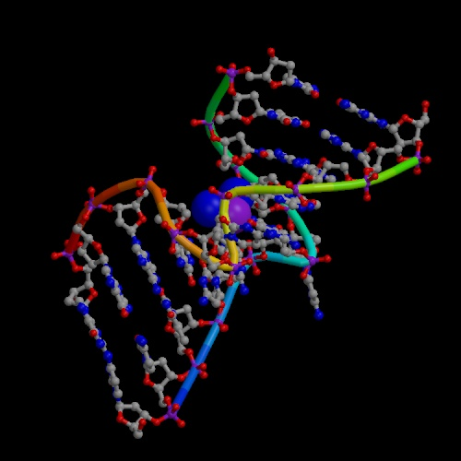
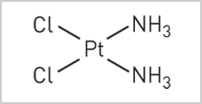
Nature 1965, 205, p. 698 –First test of anticancer activity of cisplatin

Slide 13
Cisplatin remains one of only a few inorganic compounds used as chemotherapy
Called the “ penicillin of chemotherapy”
Continue to research derivatives of cisplatin
In past years we saw it being prepared at CancerCare pharmacy

Slide 14
Naturally derived anticancer chemicals
Products of bacteria:
Streptomyces species has provided many chemicals (streptomycin=antibiotic)
Doxorubicin, daunorubicin, --Inhibitors of enzyme called topoisomerase II. It is essential for keeping DNA from tangling and knotting.
mitomycin, bleomycin—Crosslinkers, induce DNA breaks

Slide 15
Products of plants:
Topoisomerase II inhibitors
Etoposide
Teniposide
Mitotic spindle inhibitors-interact with microtubules
-vincristine
-vinblastin
-Taxol

Slide 16
Historically, plant-based medicines have been discovered by mass screenings or traditional practice.
Harvest plant
Crude separation (root, bark, leaf)
Homogenize
Ingest/apply
Today—plant products can be fractionated more specifically

Slide 17
Testing for cancer treatment
Does the homogenate/chemical have an effect on cell growth in culture?
Does the chemical have an effect on tumors in animals
Chemical may be considered for drug trial. (Future lecture)

Slide 18
Recall chapter 5?
Keep in mind, some of the same chemicals or chemical types we might associate with causing carcinogenic mutations are effective cytotoxic cancer chemotherapies.
Severe, unrepairable DNA damage in cancer cells is the goal.
We weigh the level of toxicity to non-cancer cells against the life-saving or extending effect of killing the cancer cells.

Slide 19
Tragically, some chemotherapies that cure one type of cancer, result in a second, therapy-induced cancer---often leukemia.
For example, some topoisomerase inhibitors that save the life of people with several different types of cancer, induces a fairly rapid and aggressive leukemia in 5-15% of patients.

Slide 20
Hormone therapies
Pioneered by Charles Huggins (U of Chicago). Used DMBA to cause cancer in animals and was the first to show some cancers were hormone dependent.
Removing hormone producing organs (adrenal glands, testicles) cured or reduced tumor size significantly

Slide 21
Many modern drugs designed to block hormone-initiated pathways more directly
Tamoxifen and aromatase inhibitors block activity of estrogen in breast cancer

Slide 22
Recall tumors are usually collections of very immature cells. Spending all their time dividing and not differentiating.
When cells stimulated to differentiate, they lose the ability to divide.

Slide 23
Some cancer therapies utilize differentiation agents. E.g. Acute promyelocytic leukemia-APL treatment=retinoic acid (vitamin A). Natural differentiation agent for lymphocytes.
APL shown to have mutation in retinoic acid receptor---rational approach to cure.

Slide 24
Challenges of chemotherapy
1. Cancer cells---as mentioned previously, are a perfect examples of evolution by natural selection. Some cells of the tumor acquire new mutations and become resistant to treatments. Tumors end up composed of cells that resist treatment.
Solution? Combination therapy helps---a cell is unlikely to evolve resistance to multiple mechanisms of killing.

Slide 25
Cancer stem cells
2. Much evidence emerging that tumors are derived from a small number of cells that are able to divide indefinitely. Called cancer stem cells.
Therapies seem to work all the other cells in the tumor, less well on the unique cancer stem cell.
Regardless of how many tumor cells are hit, if stem cells persist, relapse will occur.

Slide 26
New therapies in the works to identify and target the differences in cancer stem cells.

Slide 27
Toxicity
Cancer treatments all have some level of toxicity/side effects.
All related to the non-specific killing or activity on non-cancer cells in the patient. Cells that most resemble cancer cells at highest risk. (high proliferation)

Slide 28
At highest risk is bone marrow. Site of massive cell proliferation to make and replenish all types of blood cells.
Treatment doses must limit risk of destroying or damaging BM cells. Possible outcomes
Severe anemia--death
Leukemia (secondary cancer)

Slide 29
Sometimes to have any hope of cancer survival, a patient must endure bone marrow destroying chemotherapy.
Requires follow up with bone marrow or stem cell transplantation. Replenishes the patient’s bone marrow with cells to make blood cells.

Slide 30
Source of translpantable bone marrow?
Patient’s own marrow/stem cells can be removed prior to treatment and transplanted.
NO immune rejection, but may have residual cancer cells.
Genetically matched bone marrow donor.
Umbilical cord blood—parents are now offered opportunity to store.

